Slide 2
Objectives
^{Explain the Heading tag}
Explain the different tags related to formatting
Explain monospaced font, preformatted text, and block quotation
Describe the different types of lists
Explain the procedure to change the background color and image

Slide 3
Introduction
Text content of Web page forms an important part of a Web site.
Text must be attractive, easy to read, and should be short and crisp.
Text formatting options such as bold, italics, superscript, subscript, and so on must be applied to attract the user attention.
Background color and image of the Web page can be specified using HTML.

Slide 4
Headings 1-2
Heading elements define headings for contents such as text and images.
Specifies the hierarchical structure of a Web page by grouping the contents.
HTML defines six levels of headings ranging from H1 to H6.
H1 is the top level heading and is displayed with largest font size
H6 is the lowest-level heading and is displayed with smallest font size

Slide 5
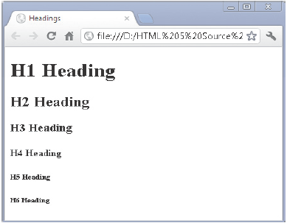
Headings 2-2
The Code Snippet demonstrates how to specify the six levels of heading in an HTML page.
^{<!DOCTYPE html>}
^{<html>}
^{<head>}
^{<title>Headings</title>}
^{</head>}
^{<body>}
^{<h1>H1 Heading</h1>}
^{<h2>H2 Heading</h2>}
^{<h3>H3 Heading</h3>}
^{<h4>H4 Heading</h4>}
^{<h5>H5 Heading</h5>}
^{<h6>H6 Heading</h6>}
^{</body>}
^{</html>}

Slide 6
HGROUP
Creates a document outline
HGROUP
Used for multiple level sub headings that can be subheadings, alternative titles, taglines and so on
<hgroup> element is the new element defined in HTML5
Groups a set of H1 to H6 elements

Slide 7
Formatting 1-5
Formatting is applied using formatting elements which are container elements
Formatting
Content format determines the appearance of the content in the browser
Formatted content makes an HTML page more readable and presentable
Text may appear in bold or underlined

Slide 8
Formatting 2-5
Commonly used formatting elements are as follows:
B element displays text in bold and is enclosed between <b> and </b> tags.
I element displays text in italics and is enclosed between <i> and </i> tags.
SMALL element makes the text appear smaller in browser and is enclosed between <small> and </small> tags.
U element underlines a text and is enclosed between <u> and </u> tags.

Slide 9
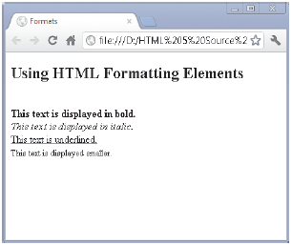
Formatting 3-5
The Code Snippet demonstrates the use of basic formatting elements.
^{<!DOCTYPE html>}
^{<html>}
^{<head>}
^{<title>Formats</title>}
^{</head>}
^{<body>}
<h2>Using HTML Formatting Elements</h2><br>
<b>This text is displayed in bold.</b><br>
<i>This text is displayed in italic.</i><br>
<u>This text is underlined.</u><br>
<small>This text is displayed smaller.</small>
^{</body>}
^{</html>}

Slide 10
Formatting 4-5
Some more formatting elements are as follows:
DEL element encloses deleted text and is placed between <del> and </del> tags.
INS element encloses inserted text and is placed between <ins> and </ins> tags.
STRONG element emphasizes the text and is placed between <strong> and </strong> tags.
SUB element displays a text as subscript and is enclosed between <sub> and </sub> tags.
SUP element displays a text as superscript and is enclosed between <sup> and </sup> tags.

Slide 11
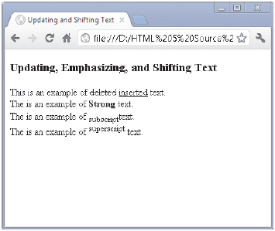
Formatting 5-5
The Code Snippet demonstrates the use of other formatting elements.
^{<!DOCTYPE html>}
^{<html>}
^{<head>}
<title>Updating and Shifting Text</title>
^{</head>}
^{<body>}
<h3>Updating, Emphasizing, and Shifting Text</h3>
This is an example of <del>deleted</del> <ins>inserted
^{</ins> text.<br/>}
The is an example of <strong>Strong</strong> text.<br/>
The is an example of <sub>subscript</sub>text.<br/>
The is an example of <sup>superscript</sup> text.<br/>
^{</body>}
^{</html>}

Slide 12
Monospaced and Preformatted Text 1-2
Monospaced font allows the same amount of horizontal space between fonts irrespective of font size, shape, and type.
Monospaced fonts are used for programming code snippets, instruction texts, and ASCII characters.
<pre> tag is used for preformatted text content.
<pre> tag applies a fixed-font width to the text content.
<pre> tag allows you to copy-paste the content along with the formatting from the source.

Slide 13
Monospaced and Preformatted Text 2-2
Following table lists some of the predefined tags and their description.
^{Tag} | ^{Description}
^{<em>} | ^{Used for emphasized text}
^{<dfn>} | ^{Used for definition term}
^{<code>} | ^{Used for computer code}
^{<samp>} | Used for sample output from a computer program
^{<cite>} | ^{Used for citation}

Slide 14
Formatting a Block Quotation
To define a long quotation or block quotation, <blockquote> tags are used.
<blockquote> tag indents the quotation in browsers.
The Code Snippet demonstrates the use of <blockquote> tags.
^{<blockquote>}
“When one door closes, another opens; but we often look so long and so regretfully upon the closed door that we do not see the one which has opened for us.” -Alexander Graham Bell
^{</blockquote>}

Slide 15
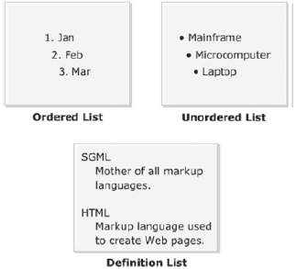
Lists
Can contain paragraphs, images, links, and other lists
Is a collection of items
Displays a list of related items
Can be organized in sequential or nonsequential manner

Slide 16
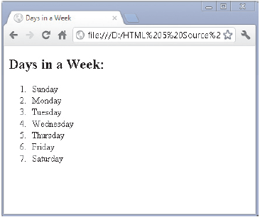
Ordered Lists 1-2
List is displayed using a numbered or alphabetic bullet
Two elements used for creating an ordered list are as follows:
^{OL – Creates an ordered list}
LI – Specifies an item and it is a sub-element of the OL element
The Code Snippet demonstrates the use of OL and LI tag.
^{<!DOCTYPE html>}
^{<html>}
^{<head>}
^{<title>Days in a Week</title>}
^{</head>}
^{<body>}
^{<h2>Days in a Week:</h2>}
^{<ol>}
^{<li>Sunday</li>}
^{<li>Monday</li>}
^{<li>Tuesday</li>}
^{<li>Wednesday</li>}
^{<li>Thursday</li>}
^{<li>Friday</li>}
^{<li>Saturday</li>}
^{</ol>}
^{</body>}
^{</html>}

Slide 17
Ordered Lists 2-2
Following table lists some of the different numbering styles and their description.
^{Property’s Value} | ^{Example}
^{decimal} | ^{1, 2, 3…}
^{lower-alpha} | ^{a, b, c…}
^{upper-alpha} | ^{A, B, C…}
^{lower-roman} | ^{i, ii, iii…}
^{upper-roman} | ^{I, II, III…}
list-style-type property is used to specify a numbering style for the ordered list.
It is the property of the style attribute, which is specified with the <ol> tags.

Slide 18
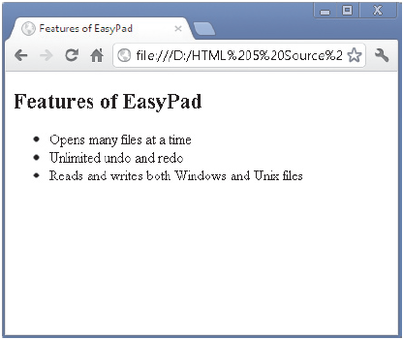
Unordered Lists 1-3
Items are arranged in random order
Two elements used for creating an unordered list are as follows:
^{UL – Creates an unordered list}
LI – Specifies an item and it is a sub-element of the OL element
The Code Snippet demonstrates the use of UL and LI tag.
^{<!DOCTYPE html>}
^{<html>}
^{<head>}
<title>Features of EasyPad</title>
^{</head>}
^{<body>}
^{<h2>Features of EasyPad</h2>}
^{<ul>}
<li>Opens many files at a time</li>
<li>Unlimited undo and redo</li>
^{<li>Reads and writes both}
^{Windows and Unix files</li>}
^{</ul>}
^{</body>}
^{</html>}

Slide 19
Unordered Lists 2-3
The list-style-type property specifies the type of bullet to be applied to an unordered list.
There are three types of bullets defined for the unordered lists:
^{Disc}
^{Square}
^{circle}
The default value is disc, which is applied to the unordered list, even if the list-style-type property is not specified.
The Code Snippet demonstrates how to apply the square bullet to an unordered list.
<!DOCTYPE html>
<html>
<head>
<title>Wild Animals</title>
</head>
<body>
<h2>Wild Animals</h2>
<ul style=”list-style-type:square”>
<li>Lion</li>
<li>Tiger</li>
<li>Leopard</li>
<li>Wolf</li>
</ul>
</body>
</html>

Slide 20
Unordered Lists 3-3
The list-style-type property of the style attribute is set to square.
Hence, the unordered list of wild animals will be displayed using the square bullet as shown in the figure.

Slide 21
Definition List 1-3
Refers to a collection of terms with their corresponding descriptions
Contains the terms along with their descriptions
Appears with the term indented on the left followed by description on the right or on next line
Elements required to create a definition list are as follows:
DL – Is a container element that consists of DT and DD sub elements. Specifies that the definition list will be created using these elements.
DT – Specifies the term to be defined or described.
DT – Specifies the definition or description of the term.

Slide 22
Definition List 2-3
Steps to create a definition list are as follows:
1. Specify the DL element to indicate that you want to create a definition list.
2. Use the DT element to specify the term such as Common Noun.
3. Use the DD element to specify the description of the term.

Slide 23
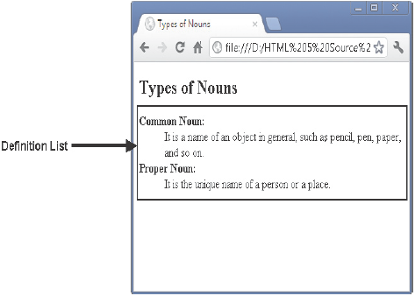
Definition List 3-3
The Code Snippet demonstrates the way to create a definition list.
^{<!DOCTYPE html>}
^{<html>}
^{<head>}
^{<title>Types of Nouns</title>}
^{</head>}
^{<body>}
^{<h2>Types of Nouns</h2>}
^{<dl>}
^{<dt><b>Common Noun:</b></dt>}
<dd>It is a name of an object in general, such as
pencil, pen, paper, and so on.</dd>
^{<dt><b>Proper Noun:</b></dt>}
<dd>It is the unique name of a person or a place.
^{</dd>}
^{</dl>}
^{</body>}
^{</html>}

Slide 24
Background and Foreground Colors 1-2
Background properties specify the background color and image for the Web pages.
Background property is a shorthand property that specifies all the background properties in just one declaration.
bgcolor attribute specifies the background color of a document.
^{Syntax for bgcolor is:}
<body bgcolor=”color_name|hex_number|rgb_number”>
^{where,}
color_name - Specifies the background color with a color name (such as “red”)
hex_number - Specifies the background color with a hex code (such as “#ff0000”)
rgb_number - Specifies the background color with an rgb code (such as
^{“rgb(255,0,0)”)}

Slide 25
Background and Foreground Colors 2-2
Another way to specify a background color for a Web page is by using the
style=“background-color: color” attribute.
This attribute must be added to the style attribute of the <body> tag.
The foreground color can be specified by using the style=“color: color” attribute.
Example demonstrating the specification of background and foreground color is:
<body style=”background-color: navy; color: yellow”>

Slide 26
Background Image File
Choose an image that blends well and looks like a single image even after tiling
Background Image
Inserts an image as the background on a Web page
Choose images with lighter shades
Background images are not recommended as the color may hide the text

Slide 27
Summary
The heading elements define headings for contents such as text and images.
The <hgroup> element is used to group titles and their subtitles.
Monospaced fonts are used for programming code scripts, instruction texts, and ASCII characters.
The <pre> tag is used to apply preformatted text content to a Web page.
To define a long quotation or block quotation, the <blockquote> tag can be used.
A list is a collection of items, which might be organized in a sequential or nonsequential manner. HTML supports three types of lists namely, ordered, unordered, and definition.
HTML provides background properties that specify the background color and image for the Web pages.

